Slide 1
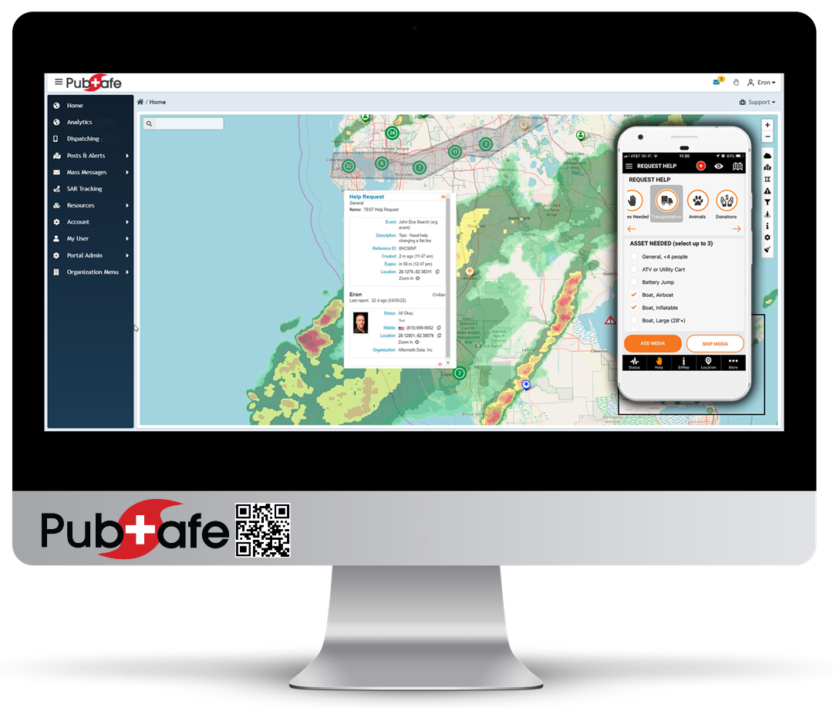
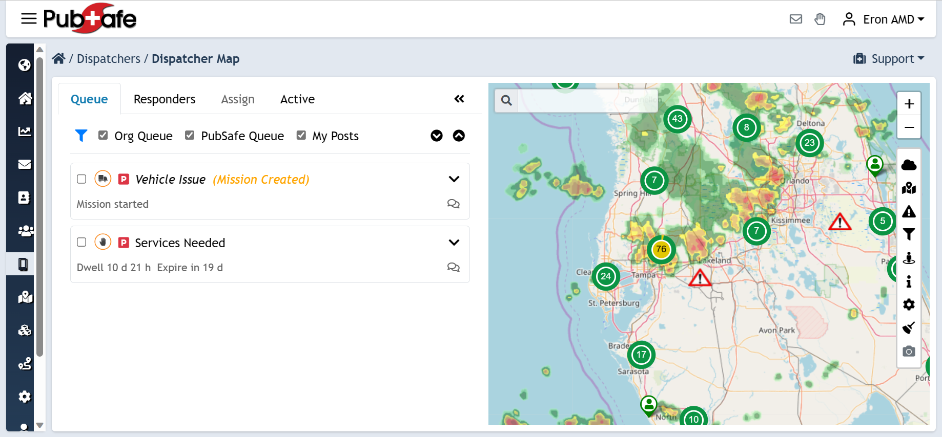
Dispatching & Communication
People Helping People & Animals

Slide 2
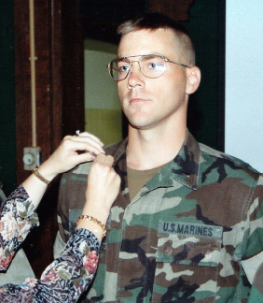
Who am I?
Florida native from Ft. Lauderdale, FL
FSU graduate
Marine Infantry Officer
Tech company owner for 22+ years in technology
Founder of PubSafe

Slide 3
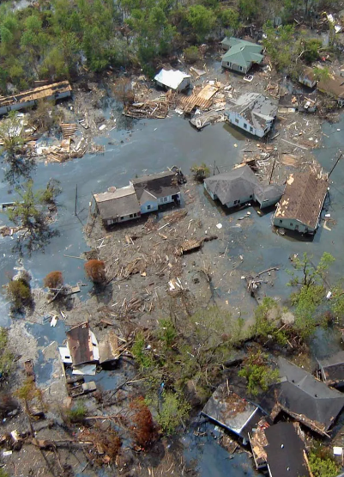
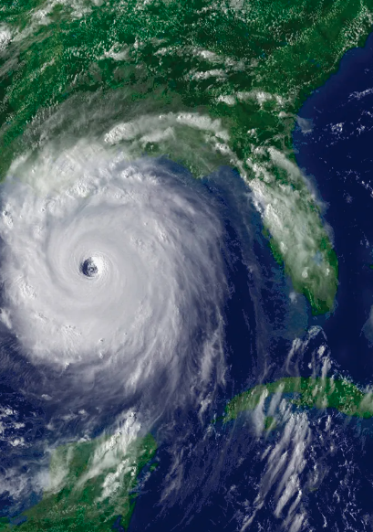
My Journey
Hurricane Katrina, 2005
Super Dome
Rooftop Rescues
Cajun Navy
Individual initiative
911 overwhelmed
Smart Phones
Truck dispatching vs Help Request dispatching

Slide 4
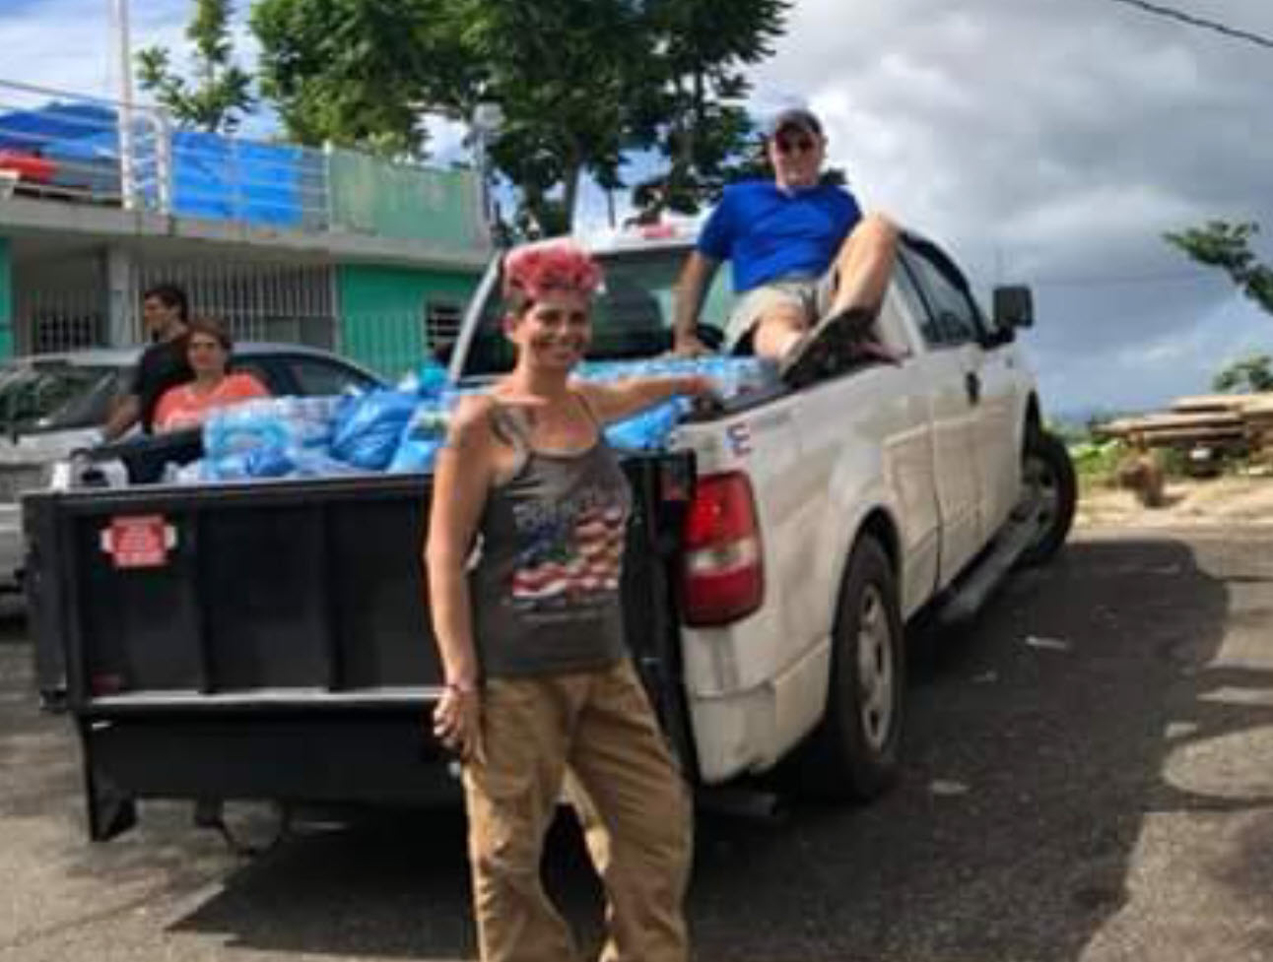
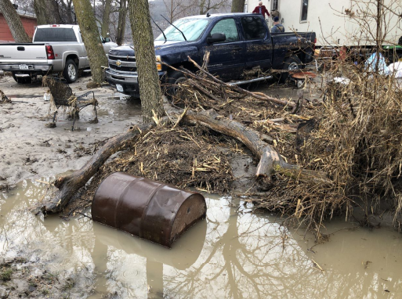
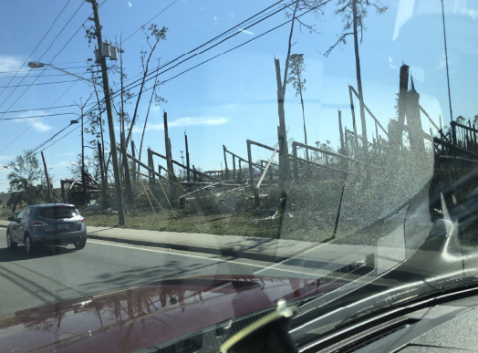
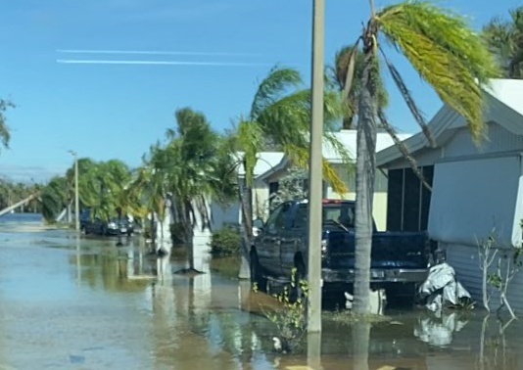
Responding
Hurricanes
Maria
Michael
Ian
Florence
Living in FL for 40 yrs
Floods
Nebraska
Observe conditions
Speak with citizens
Learn from NGOs
Listen to communication “radio chatter” Zello

Slide 5
Current Challenges
White noise
Tracking people, assets, victims
Inefficient communication
Information silos
Manual dispatch or limited efficiency
Online spreadsheets
Lack of real-time information
Cell phone networks

Slide 6
Goal of Any Solution or Technology
Save lives
Reduce property damage
Focus today is on Coordination and Communication

Slide 7
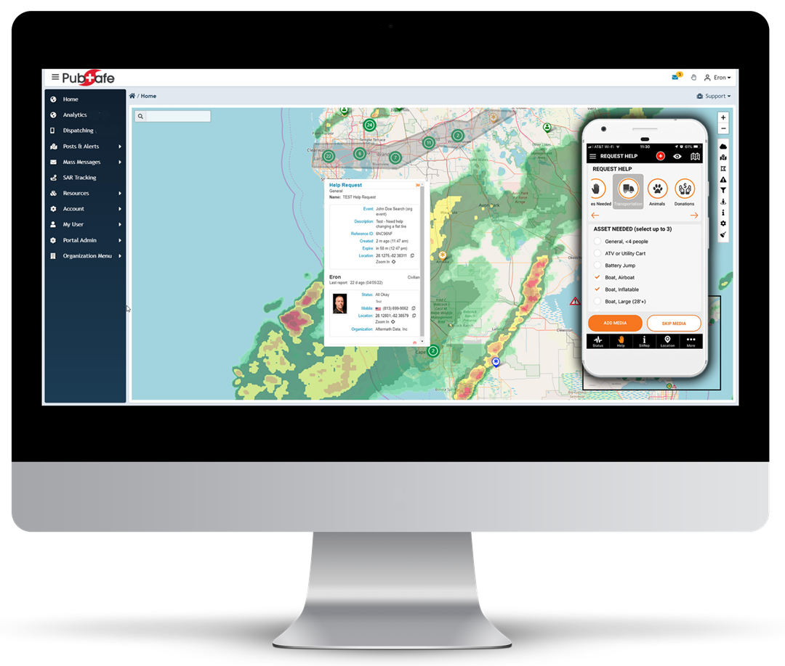
PubSafe Platform
Mobile App and Web Portal

Slide 8
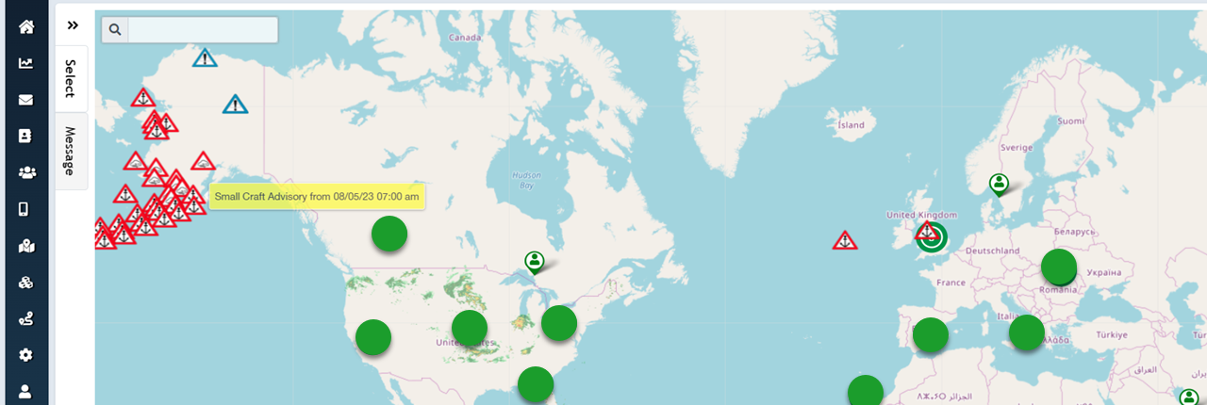
Platform for Public Safety
Consolidated platform for everyone -> globally
Global communication, visibility & dispatching
Built specifically for helping people & animals

Slide 9
Challenges of Smart Phones
Loss of cellular network --- hurricanes
Issue for all parties involved
Radio communication
Satellite communication
Mobile networks
FirstNetTM
We are all in the same situation until restored.

Slide 10
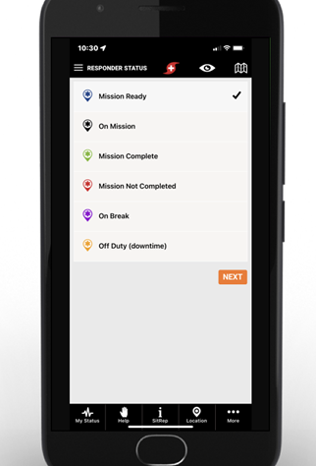
Mobile App
Closest help may be another member
Every citizen is a data node
Real-time location
Mission dispatch management
Real-time data that expires
Routine and priority help requests with exact location
SitReps
Member track history (org only)
Help fill the gap for low priority help requests
Aids in long-haul recovery

Slide 11
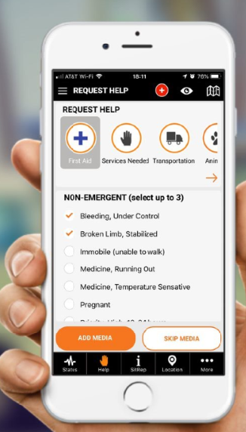
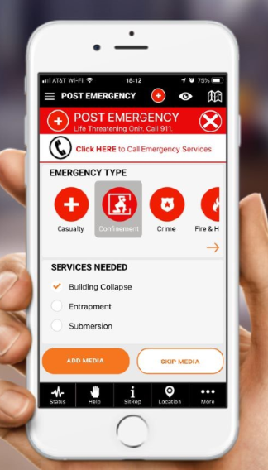
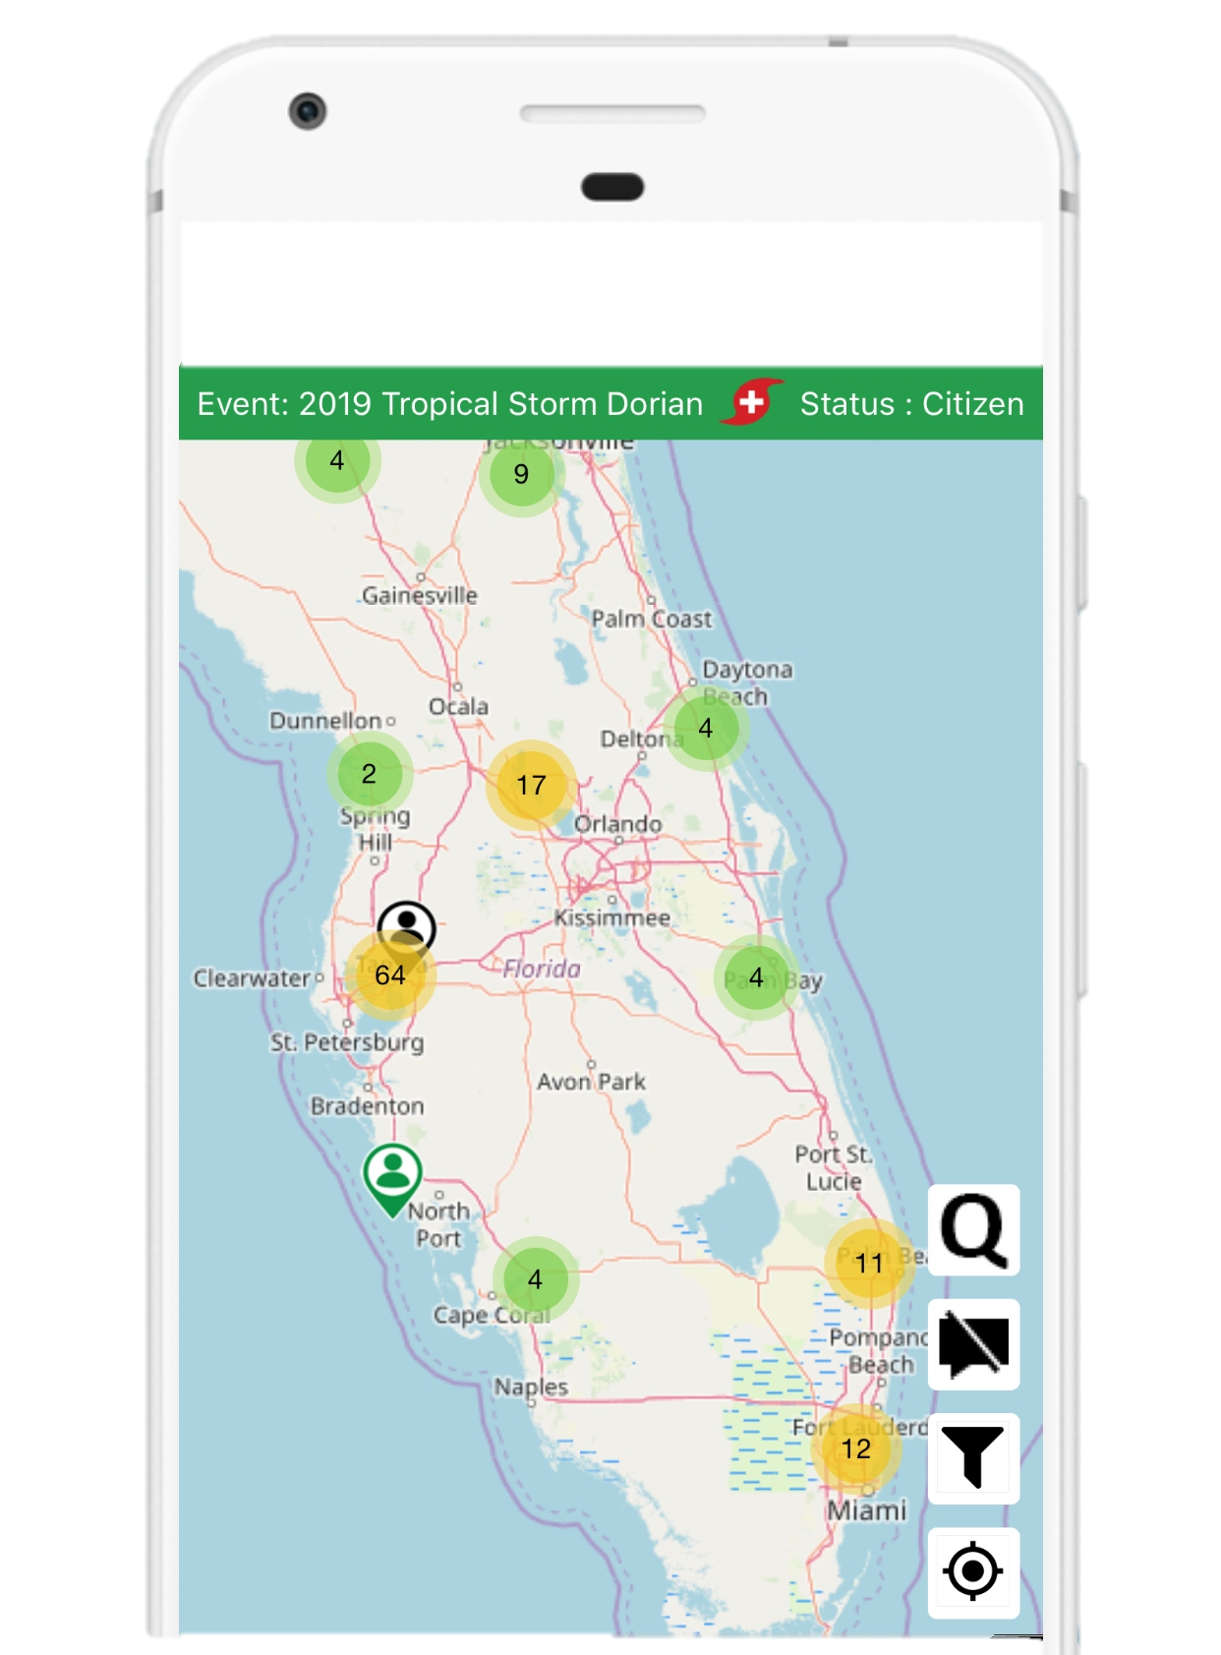
Request Help Give Help
Call 911 first

Slide 12
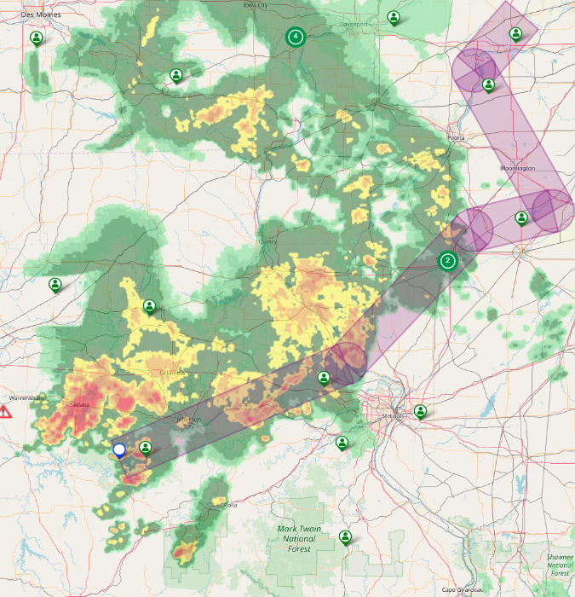
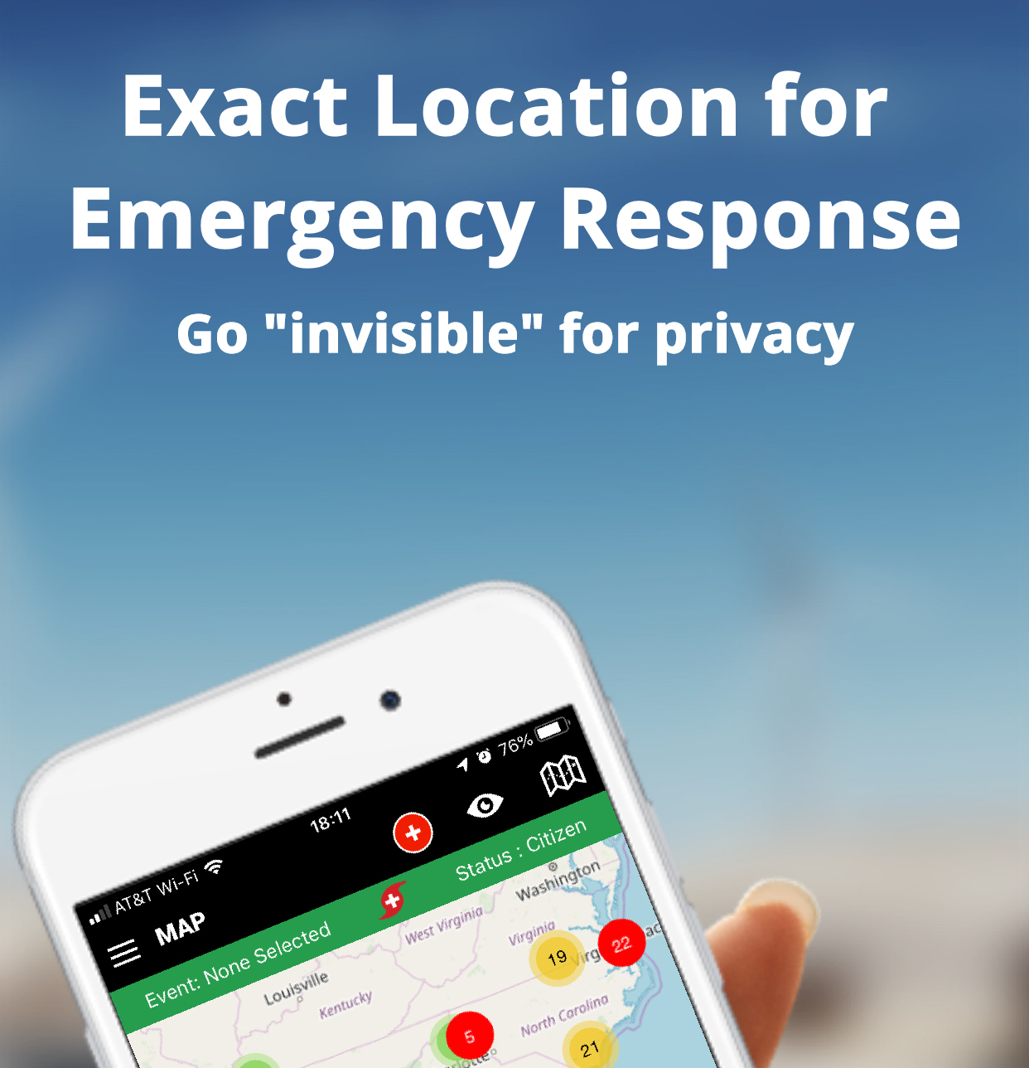

Slide 13
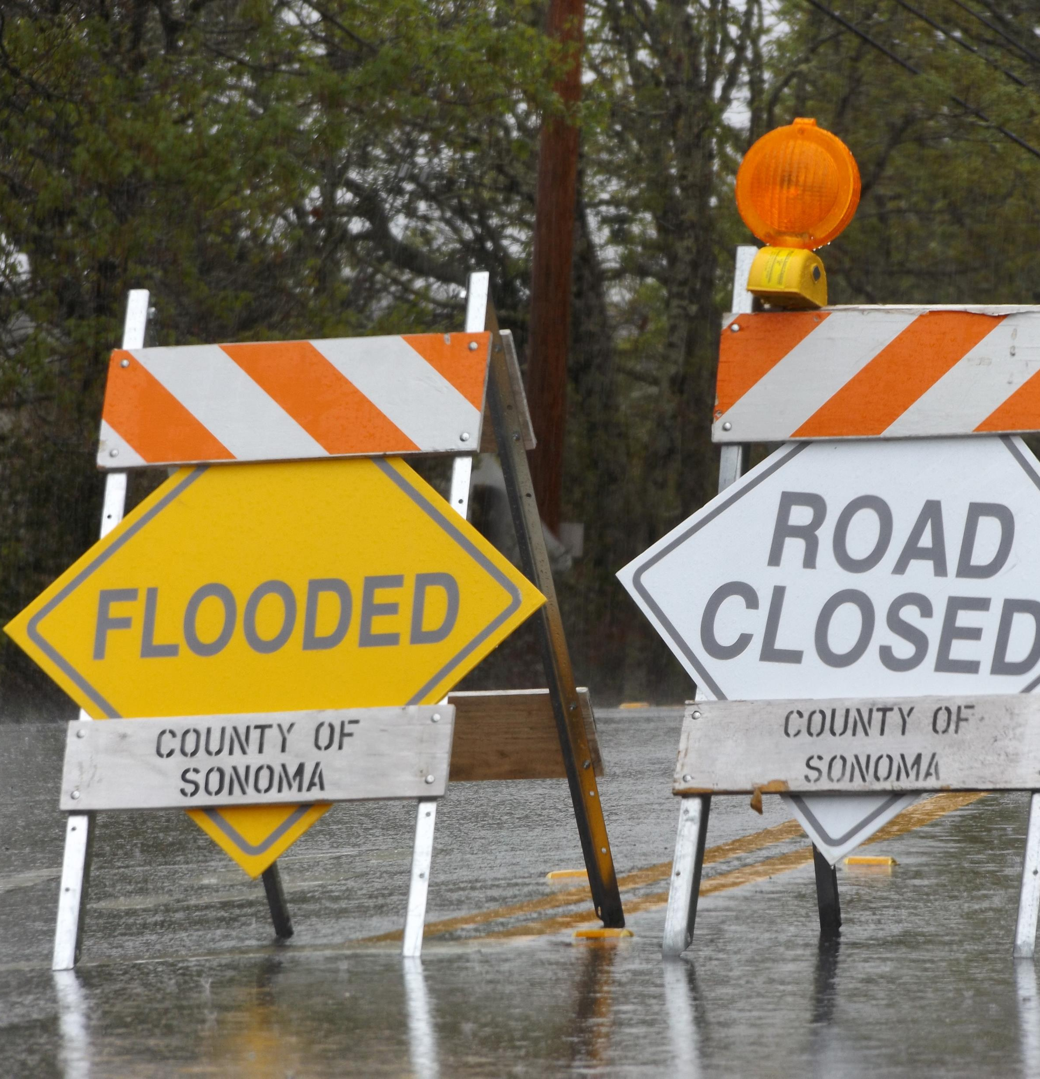
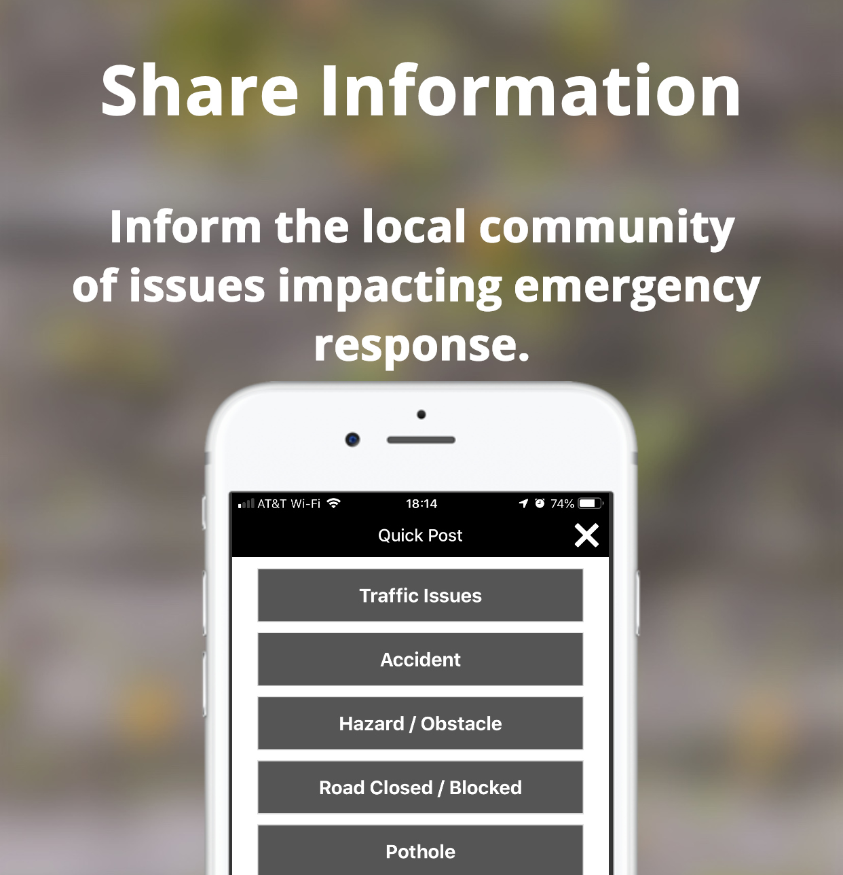

Slide 14
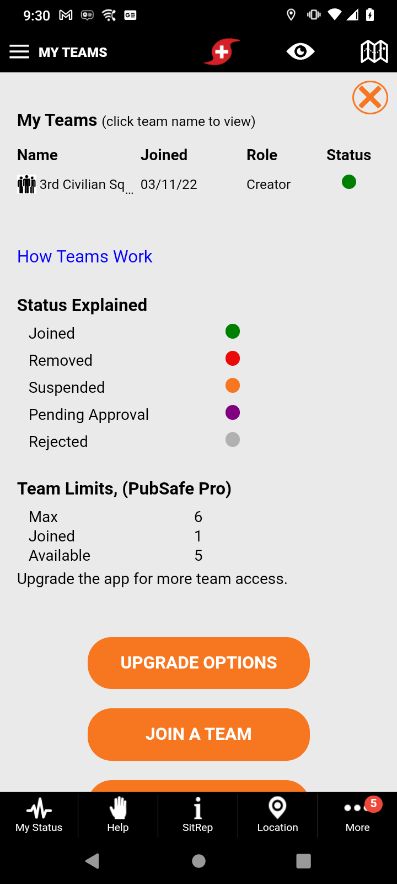
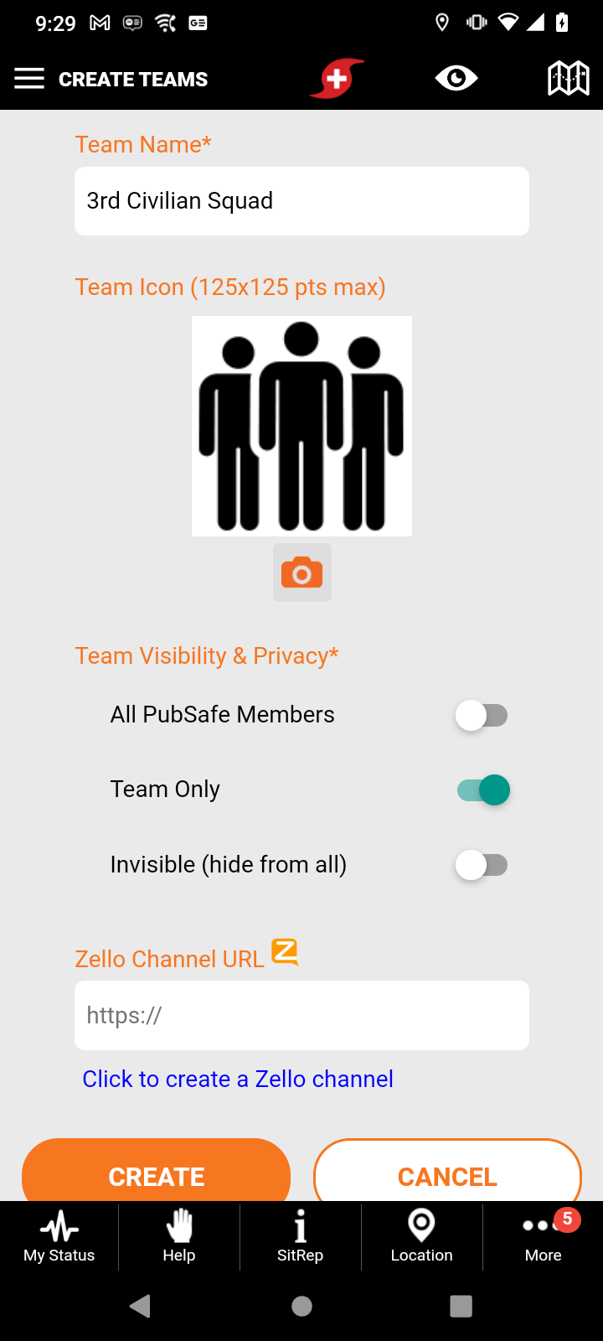
Teams
Private
Closed communication and location sharing
Examples
SAR team
Family
Church
Neighborhood
Training event

Slide 15
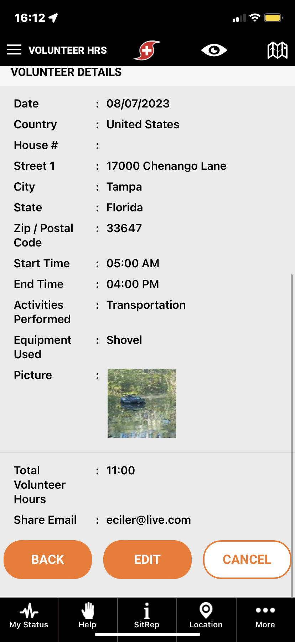
Volunteer Hours
Track volunteer hours
No double entry - Fast submission
Consolidated online
Event and organization specific

Slide 16
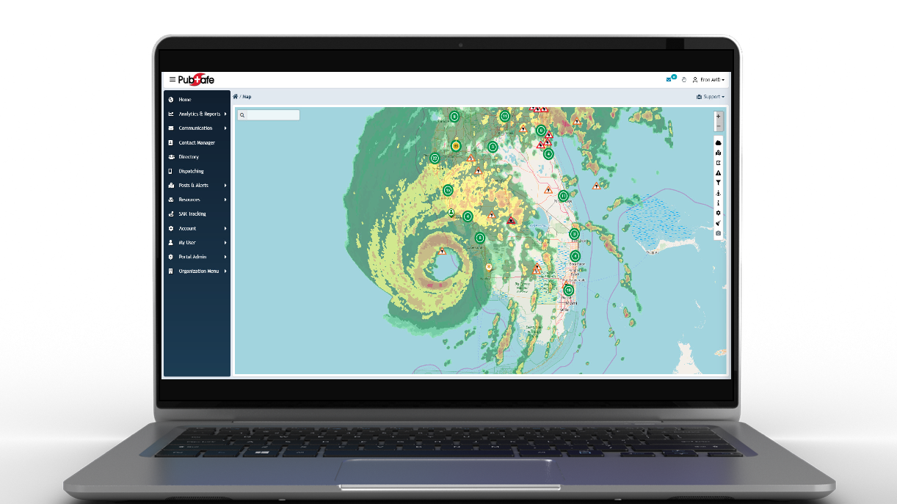
Web Portal
Built for volunteer response

Slide 17
Web Portal
Consolidation of information
Visual and text
Enabling support personnel
Constantly refining

Slide 18
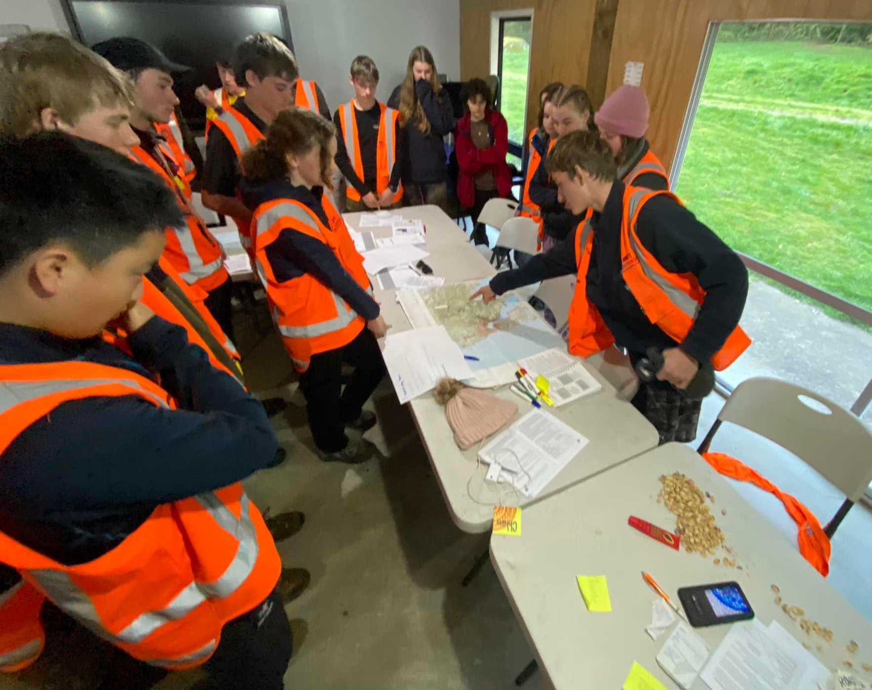
Multi-Organization Collaboration
Queue concept for case management (missions)
Real-time – Expire posts
Integrated with iPAWs, USGS, NWS, etc.
Suggestions based on skills & resources
Map determines search area
Multi organization access
Events – National & Org specific

Slide 19
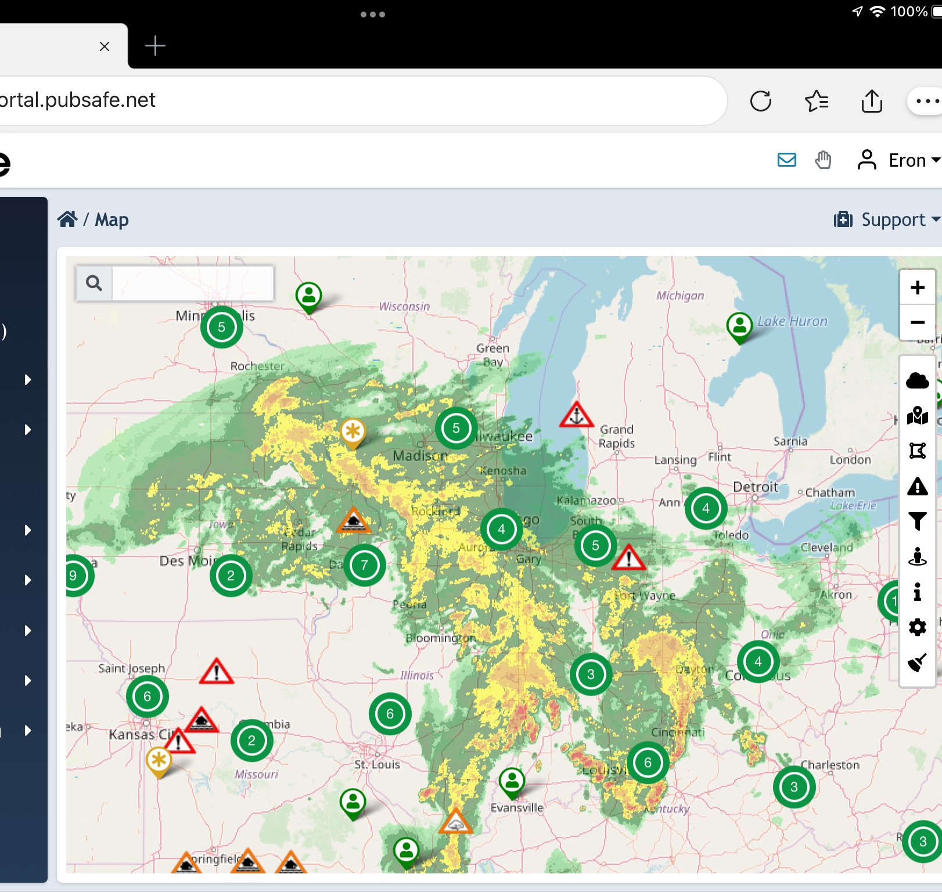
Location Sharing
Stop asking “Do we have someone in that area?”
Monitor team members globally
Dispatching efficiency
Safety
Logistics
Response time
Visibility always controlled by member

Slide 20
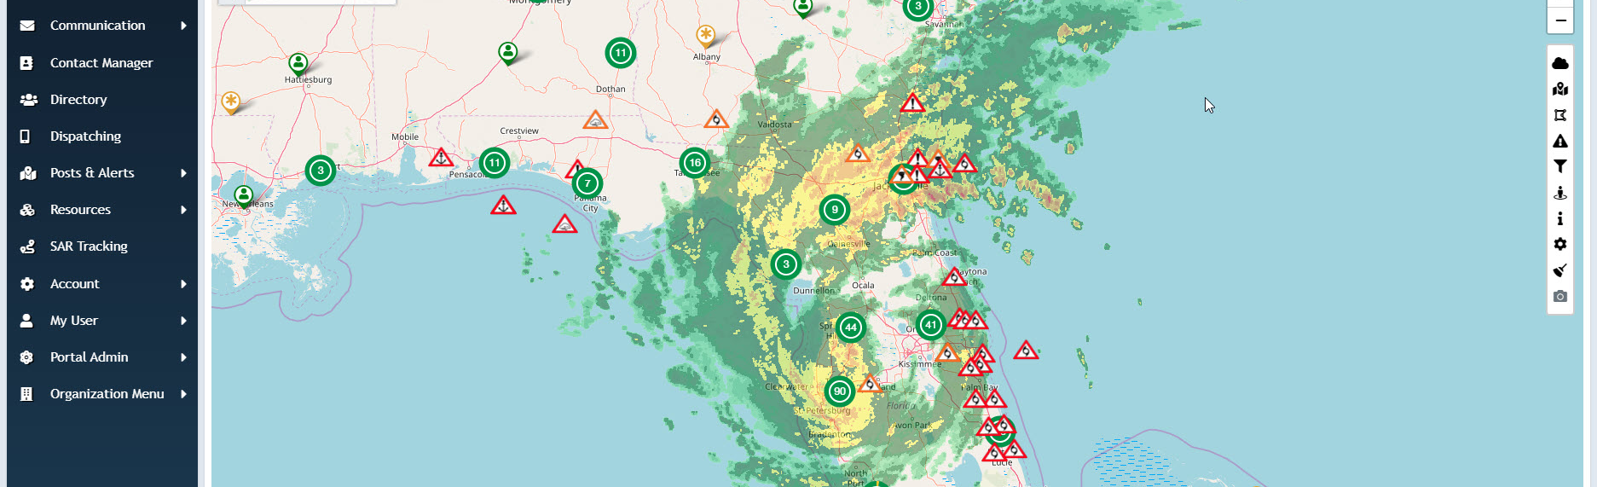
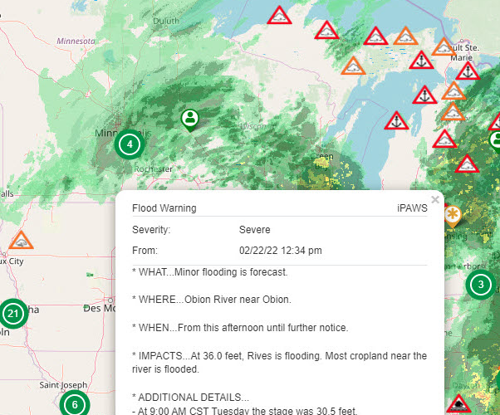
Integrated Alerts & Weather
US & Canada Current & Future Radar
National Weather Service (NWS)
US Geological Survey (USGS)
Integrated Public Alert & Warning System (iPAWS)

Slide 21
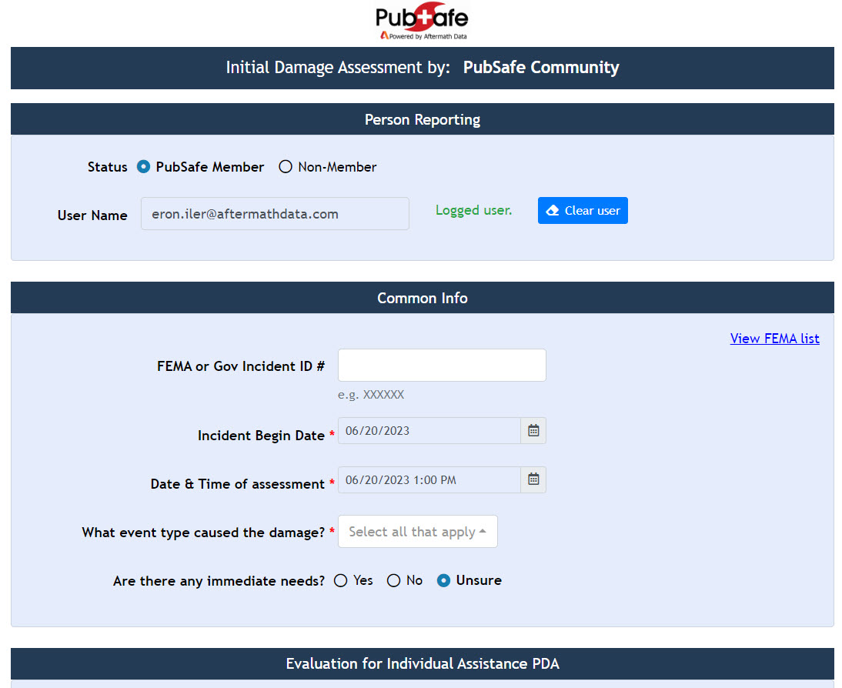
Damage Assessment
Electronic format
Phone, computer or tablet
No data entry!
Organization specific
Citizen enable
NGO enabled
Visible online
Available to share via API

Slide 22
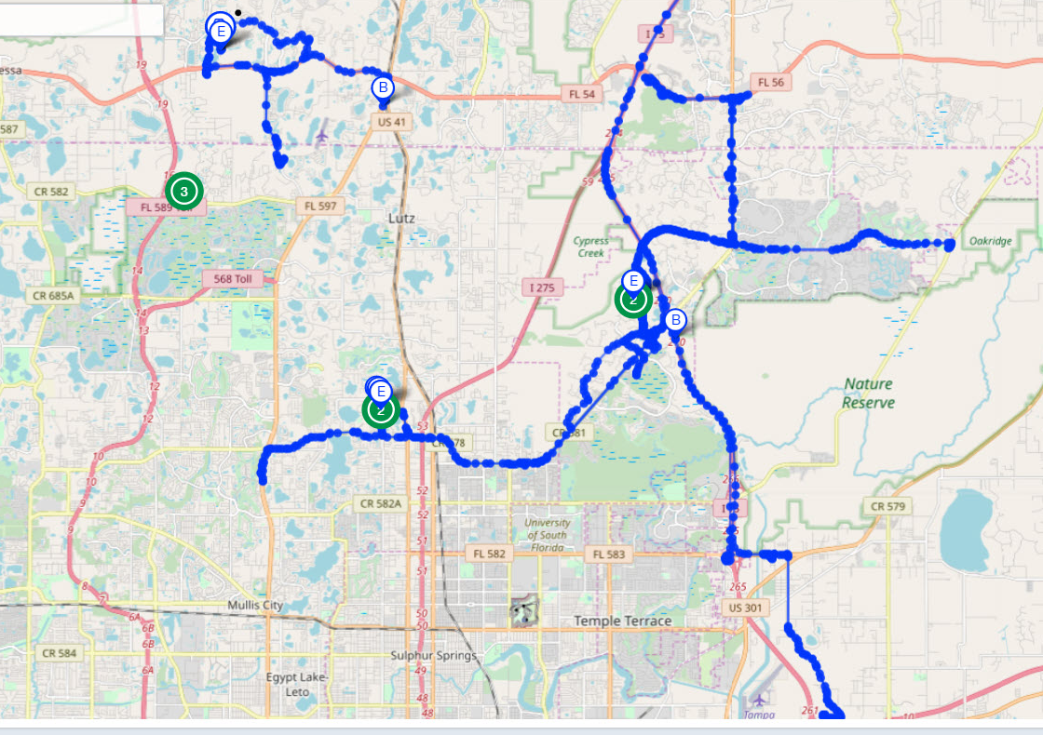
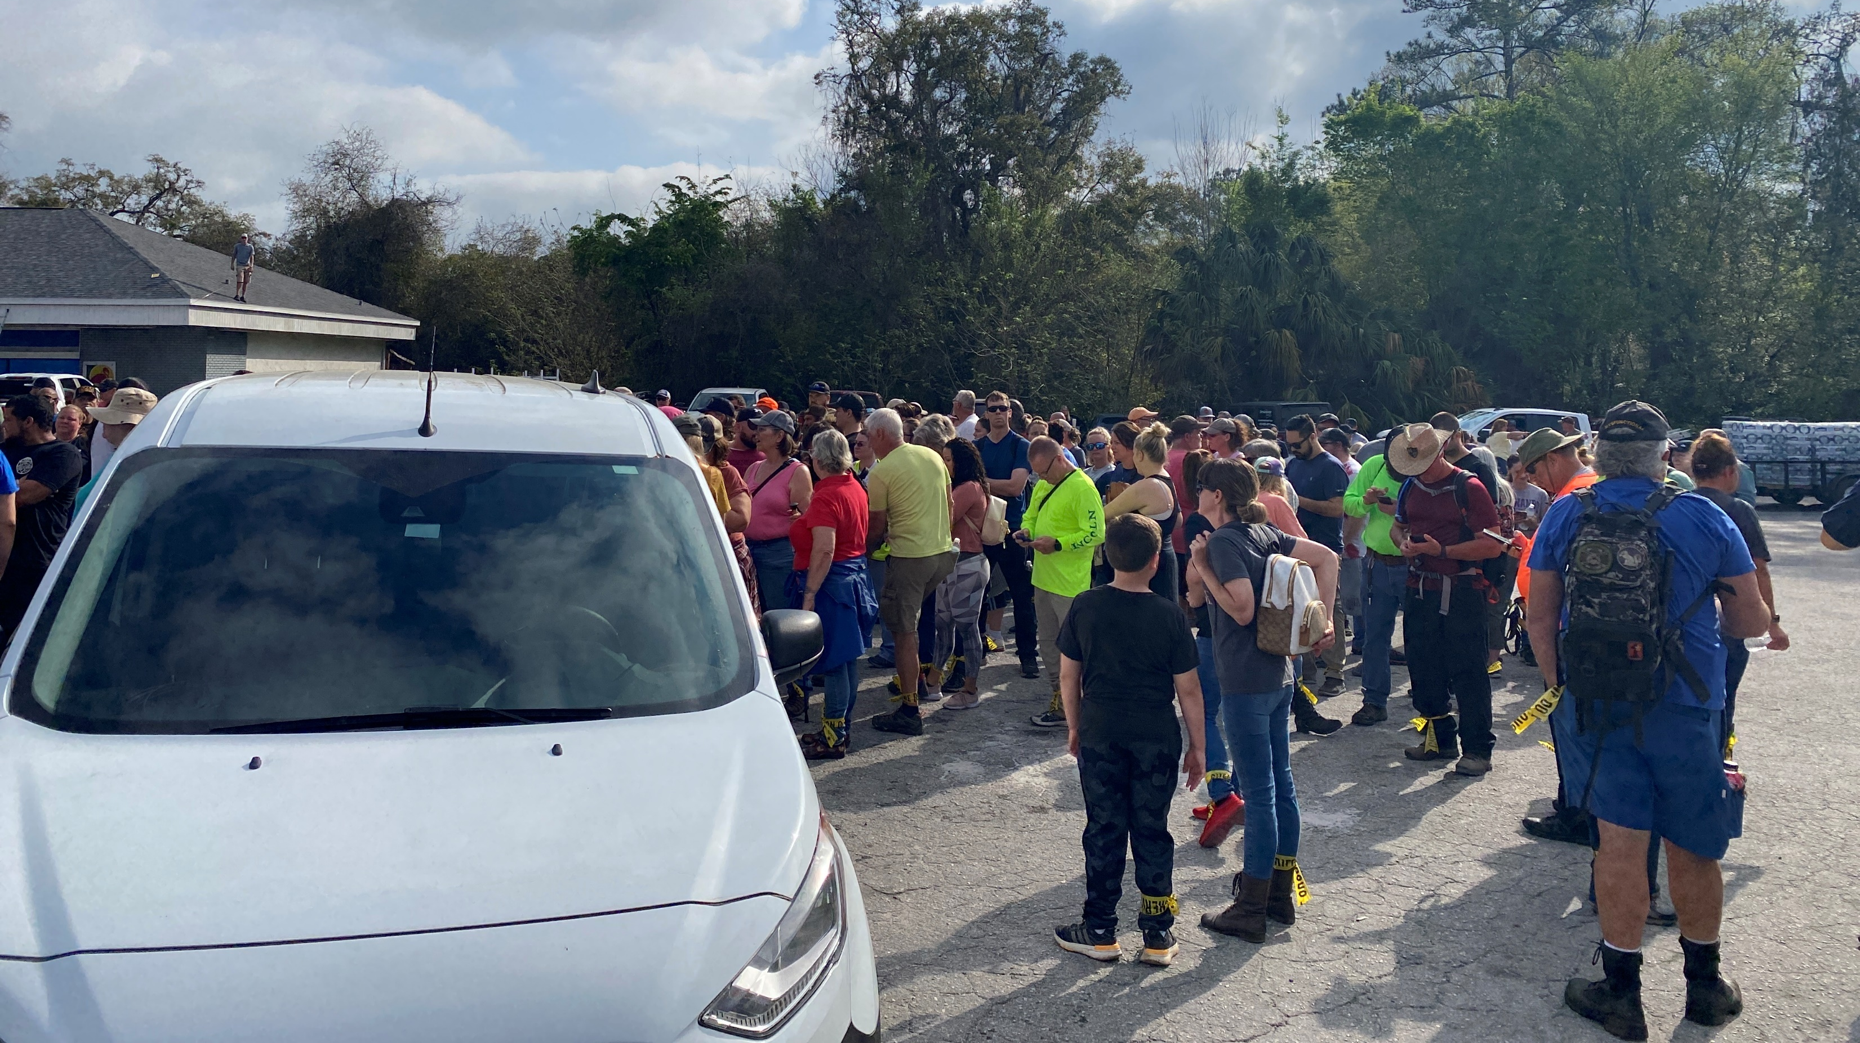
Spontaneous Volunteers
Track history to show areas searched or not searched
Limited to 96 hours
User visibility selection overrides all other settings and functions

Slide 23
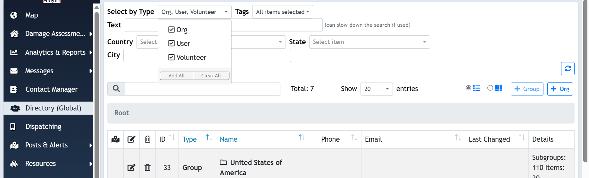
Directory
Single, online resource to store contact information
Improves access to officials & leaders
Available globally

Slide 24
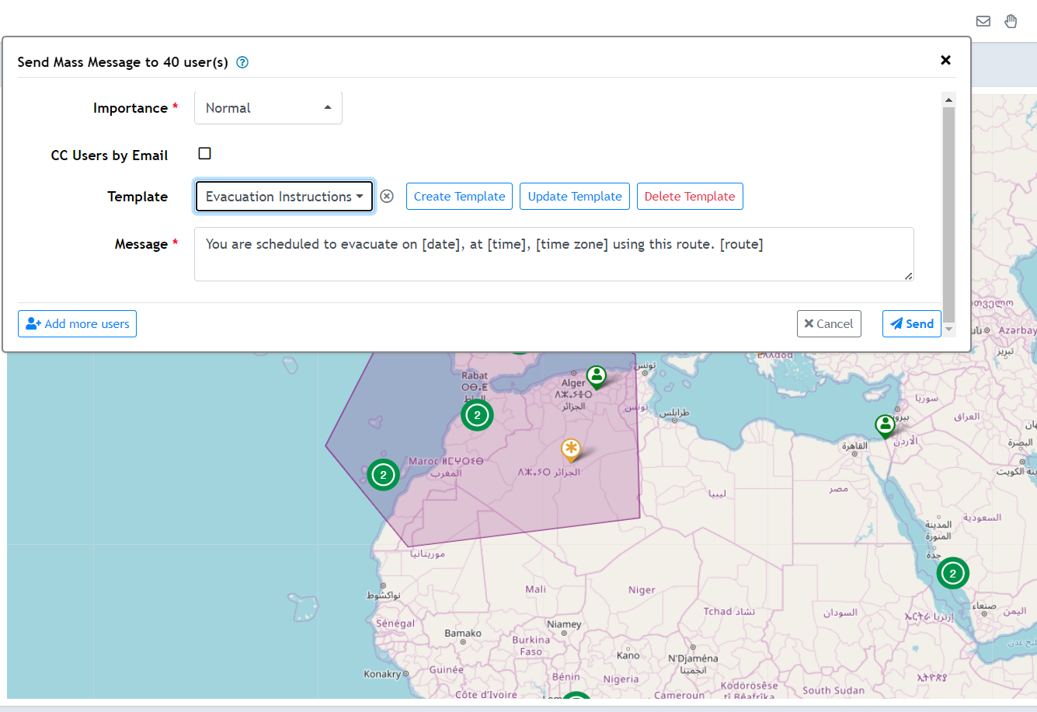
Messaging
Communicate directly with 1 or 1000’s of members
Create templates to reduce errors and increase speed
Government can message any members
Orgs can message org members
Works globally

Slide 25
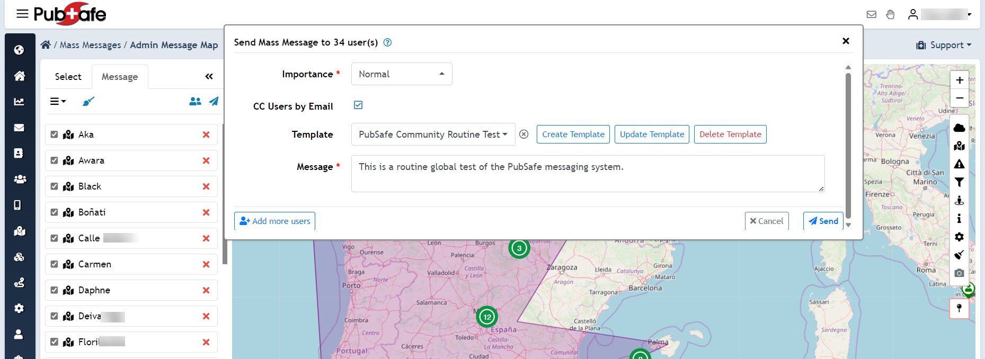
Messaging
Integration between web and mobile
Global communication
Targeted selection
Early warning for communities or regions
Rapid communication to PubSafe mobile app

Slide 26
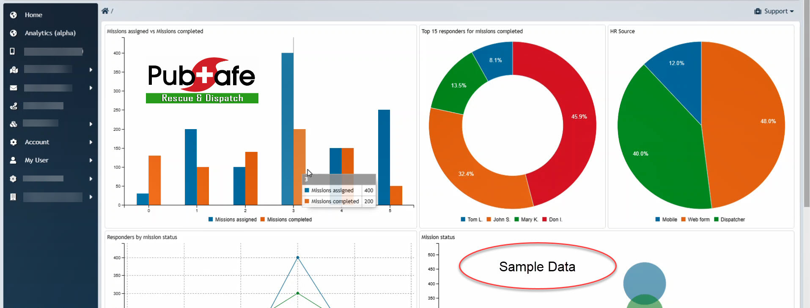
Analytics
Measure performance
Market contribution
Improve response
Confirm equitable response

Slide 27
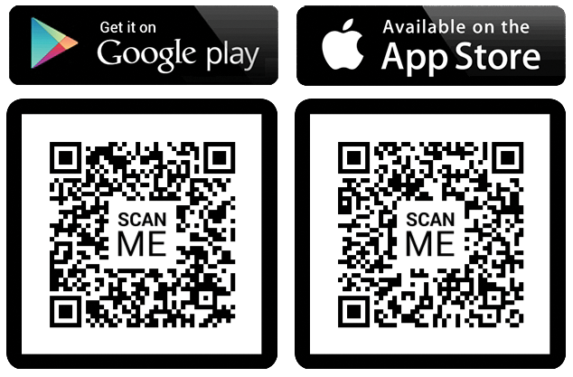
Scan to Get the Free PubSafe App

Slide 28
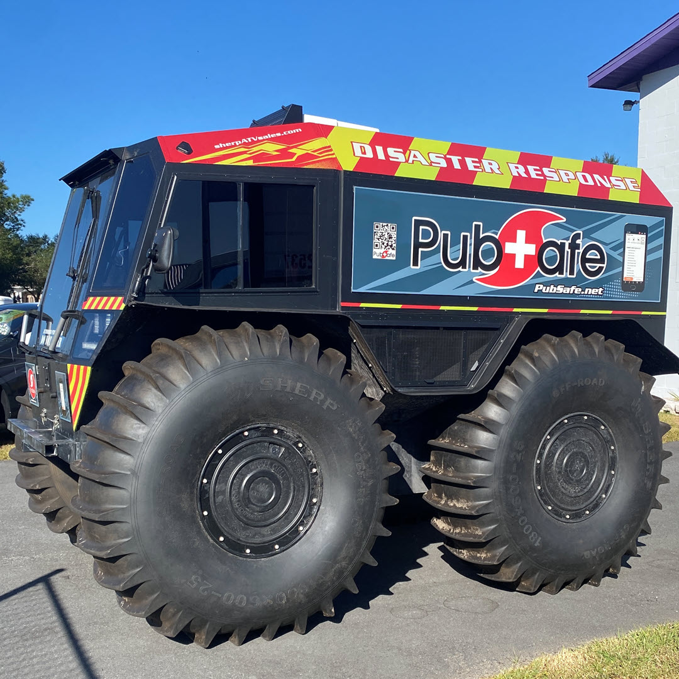
Organizations
Orgs 90-day free trial
Only $99/yr. for web tools
$5/mo. for Pro member subscription
No contract, month-to-month
Pay via app markets

